Slide 1
Smart Baggage Tracking
CSE 745 SEMINAR (Parush Garg)

Slide 2
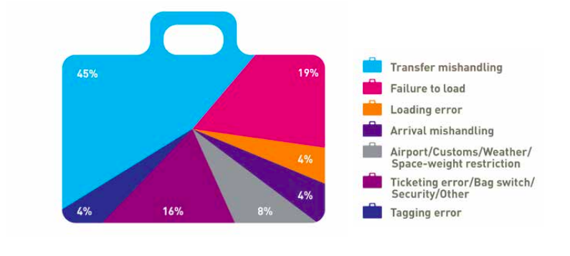
Why do we need tracking?
Source: SITA

Slide 3

Your expression when baggage is lost?

Slide 4
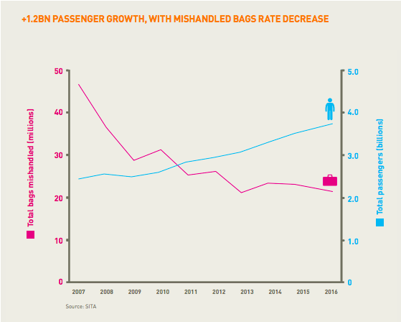
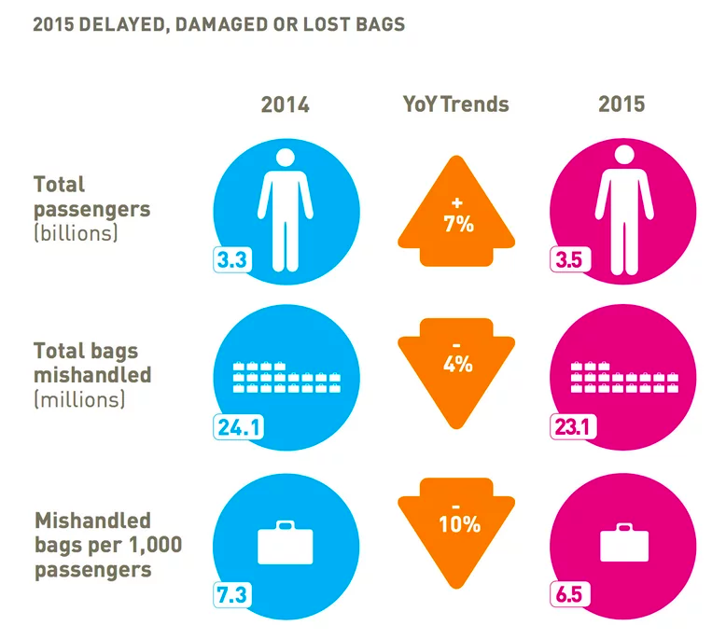
Benefits with IoT?
Souce : SITA

Slide 5
Background?
Before:
Connectivity using SIM Card to retrieve the location. ^{[1]}
Possible only when traveling in Domestic Airlines.
UI not available for users. Only for airlines internal use.
Not possible for travel with more than 6 hours duration.
Using RFID to track the baggage – costly. ^{[2]}
After:
Seamless connectivity using GPS board.
Possible in travel across the world and battery backup provided.
UI available for users in order to track the baggage.
1: Baggage tracking using Sim card
2: RFID baggage tracking

Slide 6
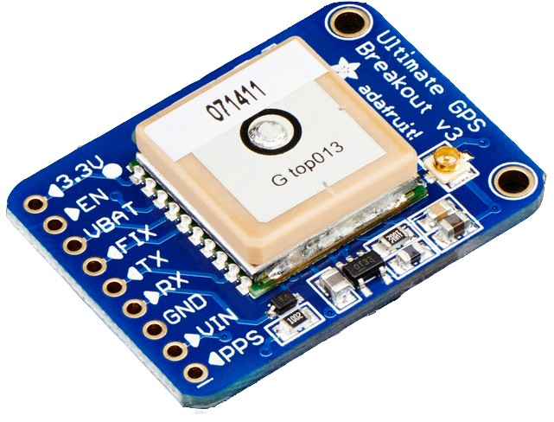
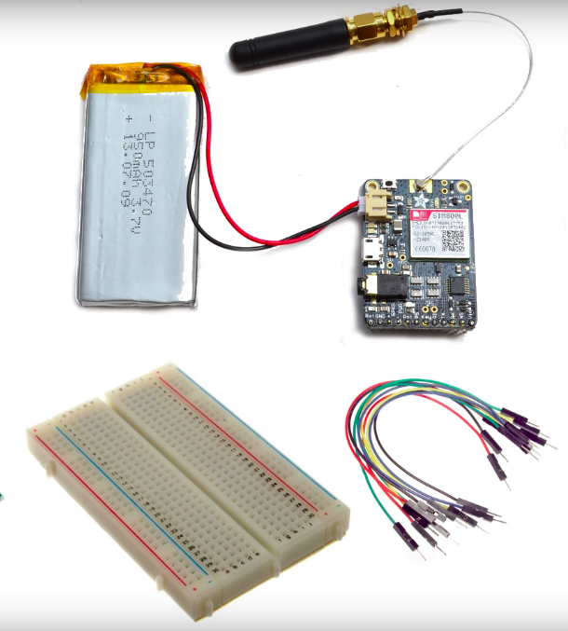
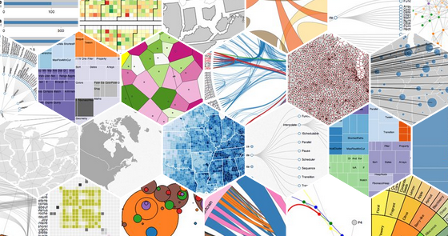
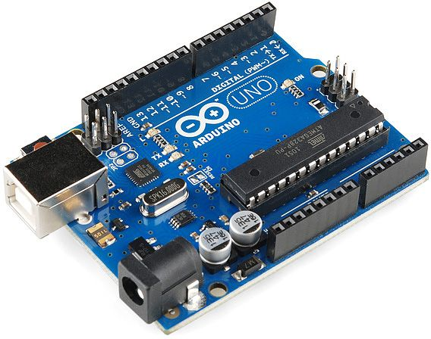

How?
1 - Adafruit Ultimate GPS Breakout
2 – Arduino UNO
3 – Battery, Antenna, Jumper wires, etc
4 – Data sent on cloud
5 – Data Analytics

Slide 7
How in detail?
Power Arduino and connect it to GPS.
External Antenna is required for better connectivities.
Save longitudes and latitudes received from GPS device.
Get API Key from ThingSpeak.
Update the location over HTTP protocol.
Collect data sent over cloud on portal.
Analyze and Visualize.

Slide 8
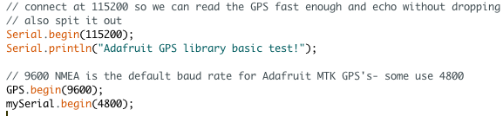
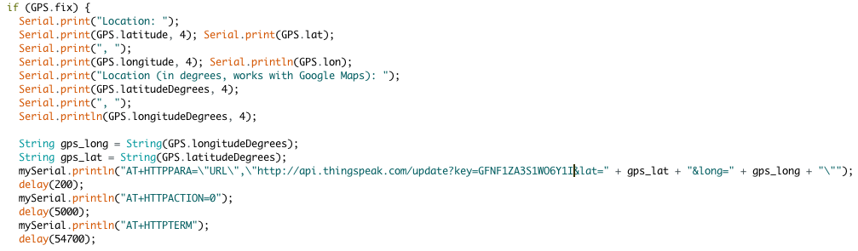
Code in detail? (Using Arduino IDE)
Using SoftSerial library for connecting GPS and updating the location on cloud.^{[1]}
Use of ThingSpeak API to update the coordinates over cloud. ^{[2]}
1: SoftSerial library by Arduino
2: Adafruit GPS
*: Full code. Click here

Slide 9
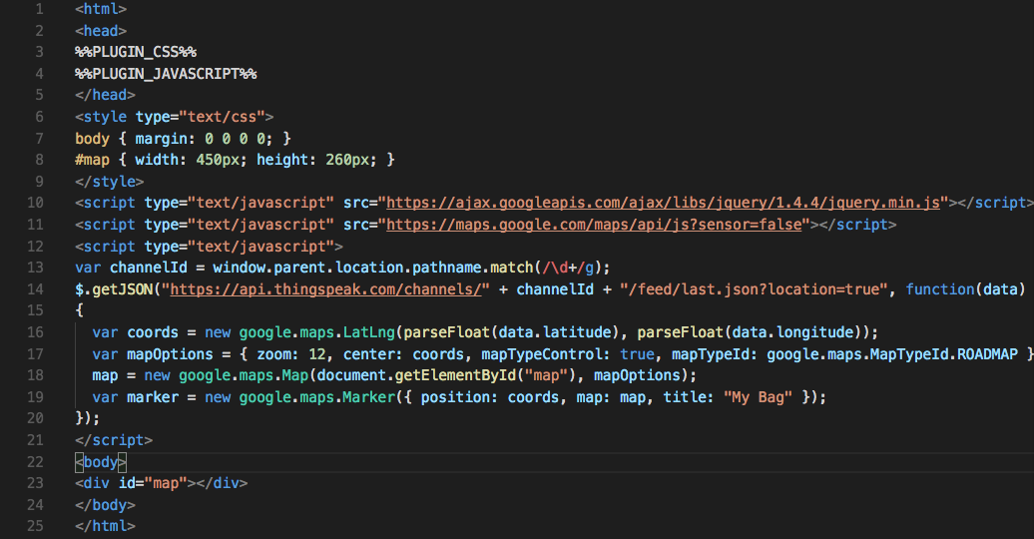
ThingSpeak in detail?
Open source Internet of Things (IoT) application and API to store and retrieve data from things using HTTP protocol over Internet. ^{[1]}
1: Login ThingSpeak
2: API Key for ThingSpeak

Slide 10
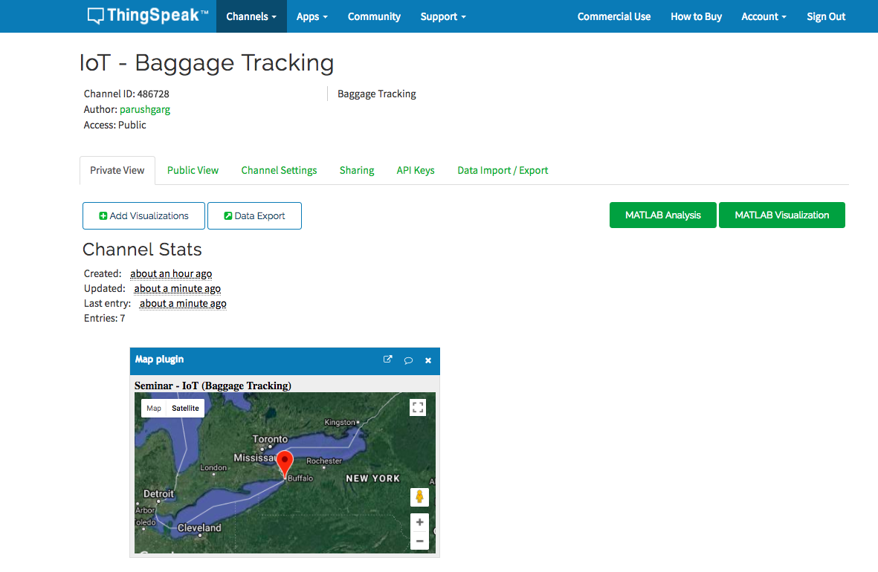
ThingSpeak in detail? (cont)

Slide 11
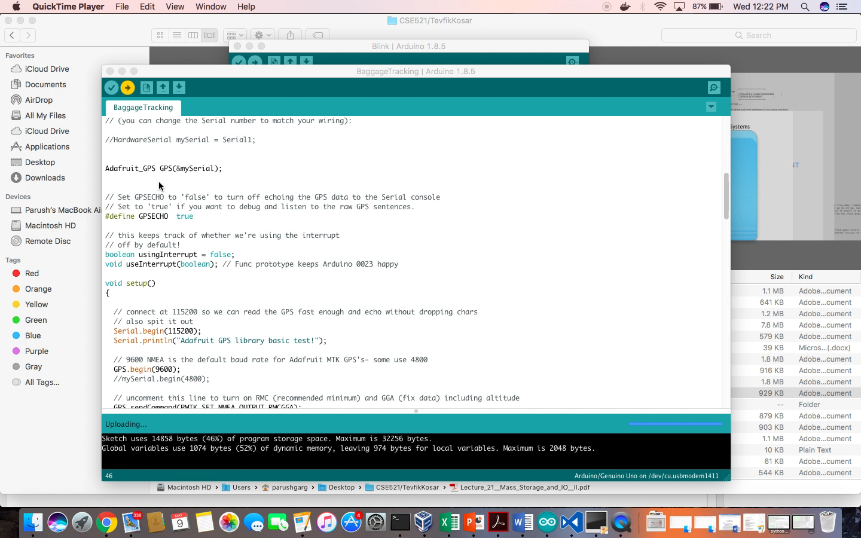
Video? (cont)

Slide 12
Improvements?
Use of external Antenna in order to capture the best signals from the GPS. ^{[1]}
Use of accelerometer so that it would sense when the plane accelerates and breaks and use that to stop and start the reporting of its position. – A much more energy efficient solution. ^{[2]}
For areas with poor connectivity, use Adafruit WiFi + which allows you to program and connect to “Open” WiFi connections. ^{[3]}
1: External Antenna by GPS
2: Accelerometer Arduino
3: Adafruit WiFi Feather

Slide 13
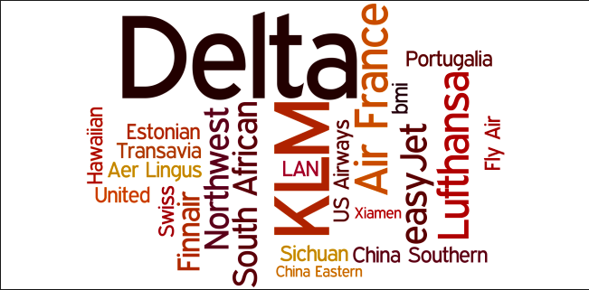
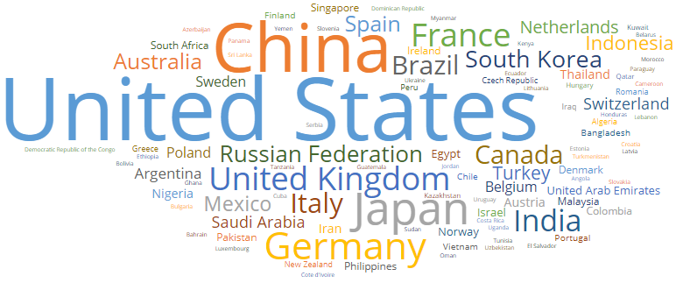
Types of Data Visualization? Using d3 JS?
Airlines Word Cloud
Countries Word Cloud

Slide 14
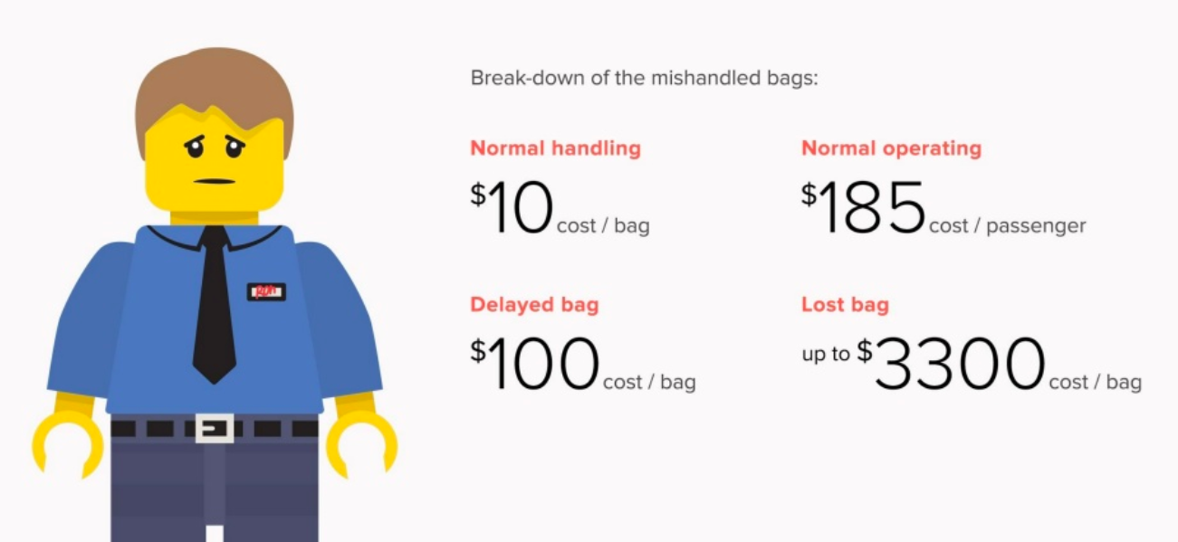
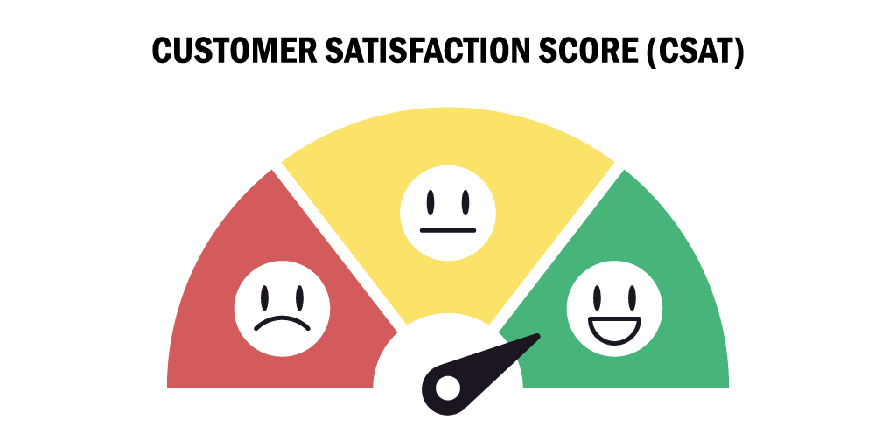
Achievements after visualization?
Source: How to visualize data?

Slide 15
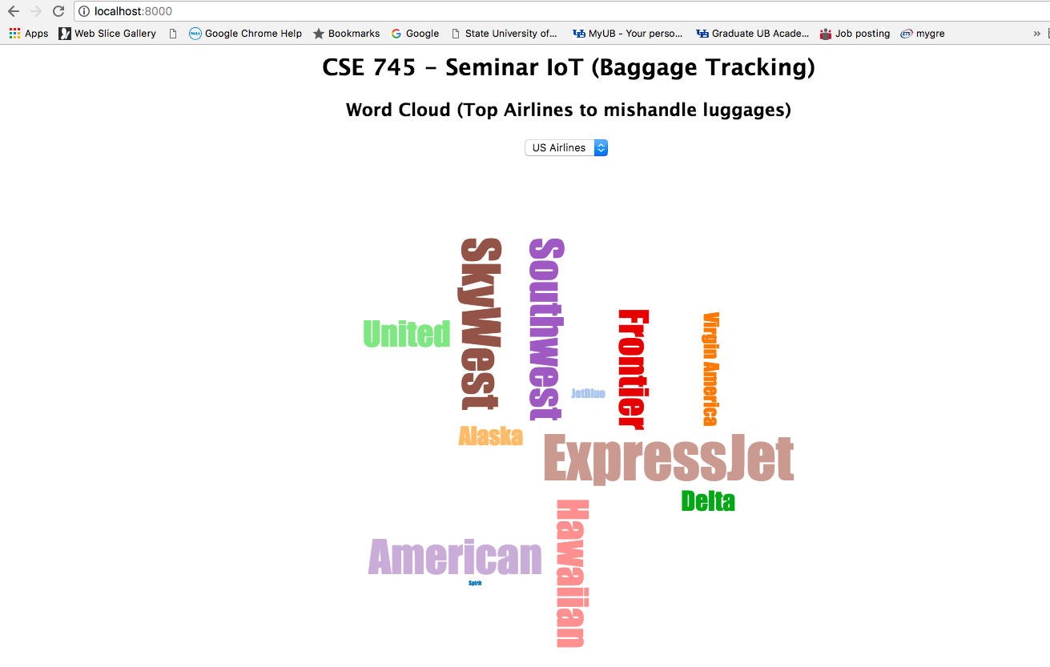
D3 Visualization on real data?
Source: SITA Data

Slide 16
Use cases?
Utilized in handling loss of luggage in airlines industries.
Satisfaction for customers.
Used as a tracker in shipments shipped using e-commerce services such as Amazon, eBay, etc.
Taken up as a personal use such as detecting where your vehicle is in a parking area.

Slide 17
References
Baggage tracking and handling system using RFID and IoT for airports – IEEE 16852788
Techniques for Detecting and Tracking of Baggages in Airports – IEEE 17303323
Delta Airlines, Alaska Airlines spent $50 million in IoT through travel
Baggage tracking in news
Tracking Airline Baggage with RFID Technology

Slide 18
THANK YOU #LoveIoT

